Slide 1
Fees and Sanctions Webinar
Thursday 5 September 2024

Slide 2
Fees and Sanctions Document
Guidance
Purpose
Contact
Produced again following the success of the 2023-24 document.
Document highlights all possible sanctions a team / institution could face during the 2024-25 season.
discipline@bucs.org.uk
events@bucs.org.uk
fixtures@bucs.org.uk

Slide 3
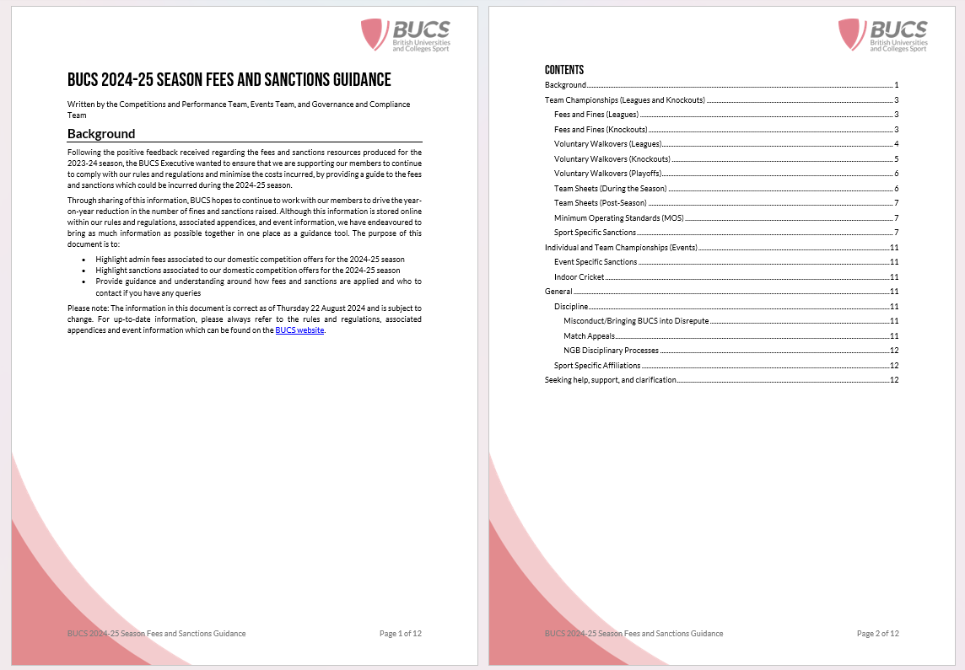
Overview

Slide 4
Top Tips
Knockout Walkovers
Collaboration
Contact Us
Understanding Deadlines
Knockout opt out for 2024-25 season has now closed.
Teams can still be withdrawn from both the league and knockout competitions for most programmes.
Most sanctionable offences can be avoided if institutions work together to resolve these outside of the formal processes
Reach out to members of the BUCS Executive as soon as you become aware of an issue.
Sport Specific Affiliations
Team Withdrawal Deadlines

Slide 5
Open Forum
Notes:
Regional – TM
National – NK

Slide 6
Some useful resources and links below, including the generic IA Training Webinar scheduled for Thursday, 12 September, from 11:00 – 13:00. [IA Resource Pack] [IA Training Webinar] [BUCS Play Help Guides] [Fees and Sanctions Document] [Fees and Sanctions Webinar] [Sport Specific Affiliations] [Latest Email Comms]
BUCS Leagues and Knockouts – fixtures@bucs.org.uk
BUCS Events – events@bucs.org.uk
BUCS Sport Governance and Compliance (Rules and Regulations) – discipline@bucs.org.uk

Slide 7
Thank you
Nick Burley, Sport Governance and Compliance Manager
Neal Kington, National Competitions Manager
Andy Gilvary, Head of Competitions and Performance

