Slide 1

Fees and Sanctions Webinar
Thursday 4 September 2025

Slide 2



Fees and Sanctions Document
Guidance
Purpose
Contact
Produced again following the success of the 2023-24 and 2024-25 documents.
Document highlights all possible sanctions a team / institution could face during the 2025-26 season.
discipline@bucs.org.uk
events@bucs.org.uk
fixtures@bucs.org.uk

Slide 3
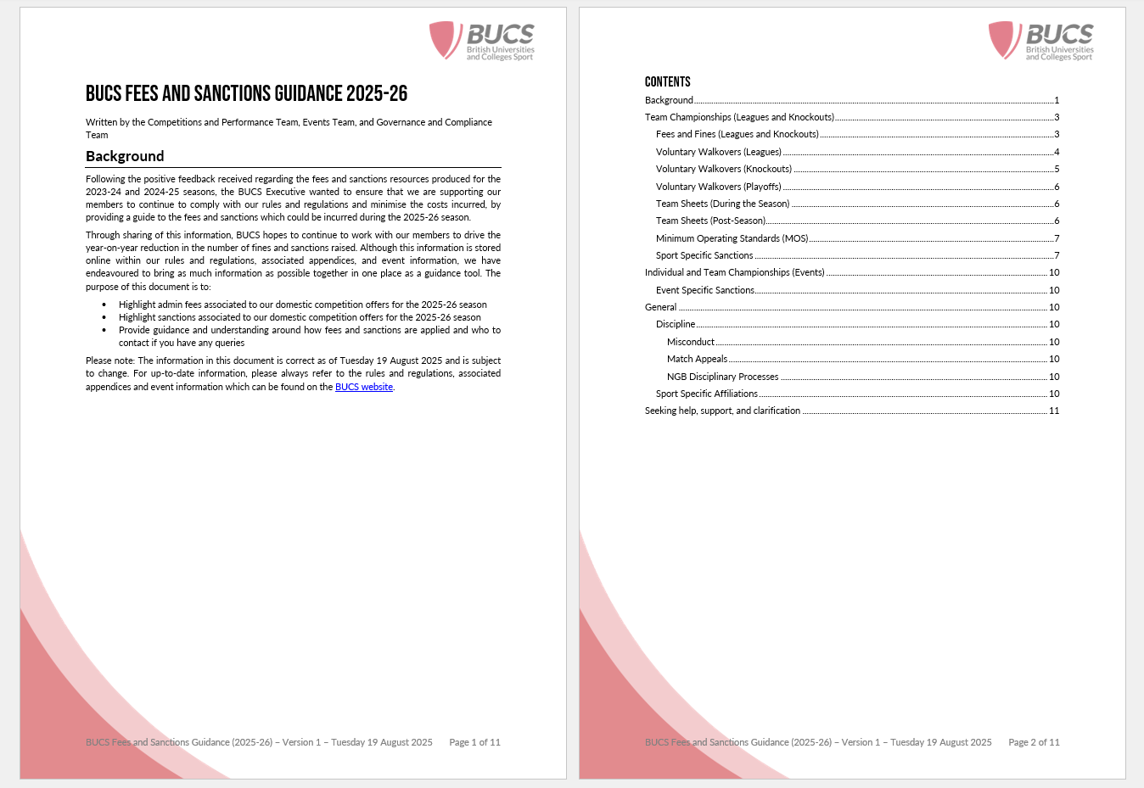
Overview

Slide 4




Top Tips
Knockout Walkovers
Collaboration
Contact Us
Understanding Deadlines
Knockout opt out for 2025-26 season (except cricket) has now closed, except for Baseball, Softball and Outdoor Ultimate, for which it will close in alignment with the relevant league deadline.
Teams can still be withdrawn from both the league and knockout competitions for most programmes.
Most sanctionable offences can be avoided if institutions work together to resolve these outside of the formal processes
Reach out to members of the BUCS Executive as soon as you become aware of an issue.
Sport Specific Affiliations
Team Withdrawal Deadlines

Slide 5

Open Forum
Notes:
Regional – TM
National – NK

Slide 6
Some upcoming webinars you may find useful:
IAs BUCS Play Training Webinar – Monday 15 September 2025, from 11:00 – 13:00
[Webinar Sign Up Link]
Leagues and Knockouts Captains BUCS Play Webinar – Monday 22 September 14:00-15:00
[Webinar Sign Up Link]
Event Captains BUCS Play Webinar – Monday 29 September at 14:00-15:00
[Webinar Sign Up Link]
Useful contacts:
BUCS Leagues and Knockouts – fixtures@bucs.org.uk
BUCS Events – events@bucs.org.uk
BUCS Sport Governance and Compliance (Rules and Regulations) – discipline@bucs.org.uk

Slide 7
Thank you
Will Spendlove, Sport Compliance Coordinator
Max Bergin, National Competitions Coordinator

